Slide 1
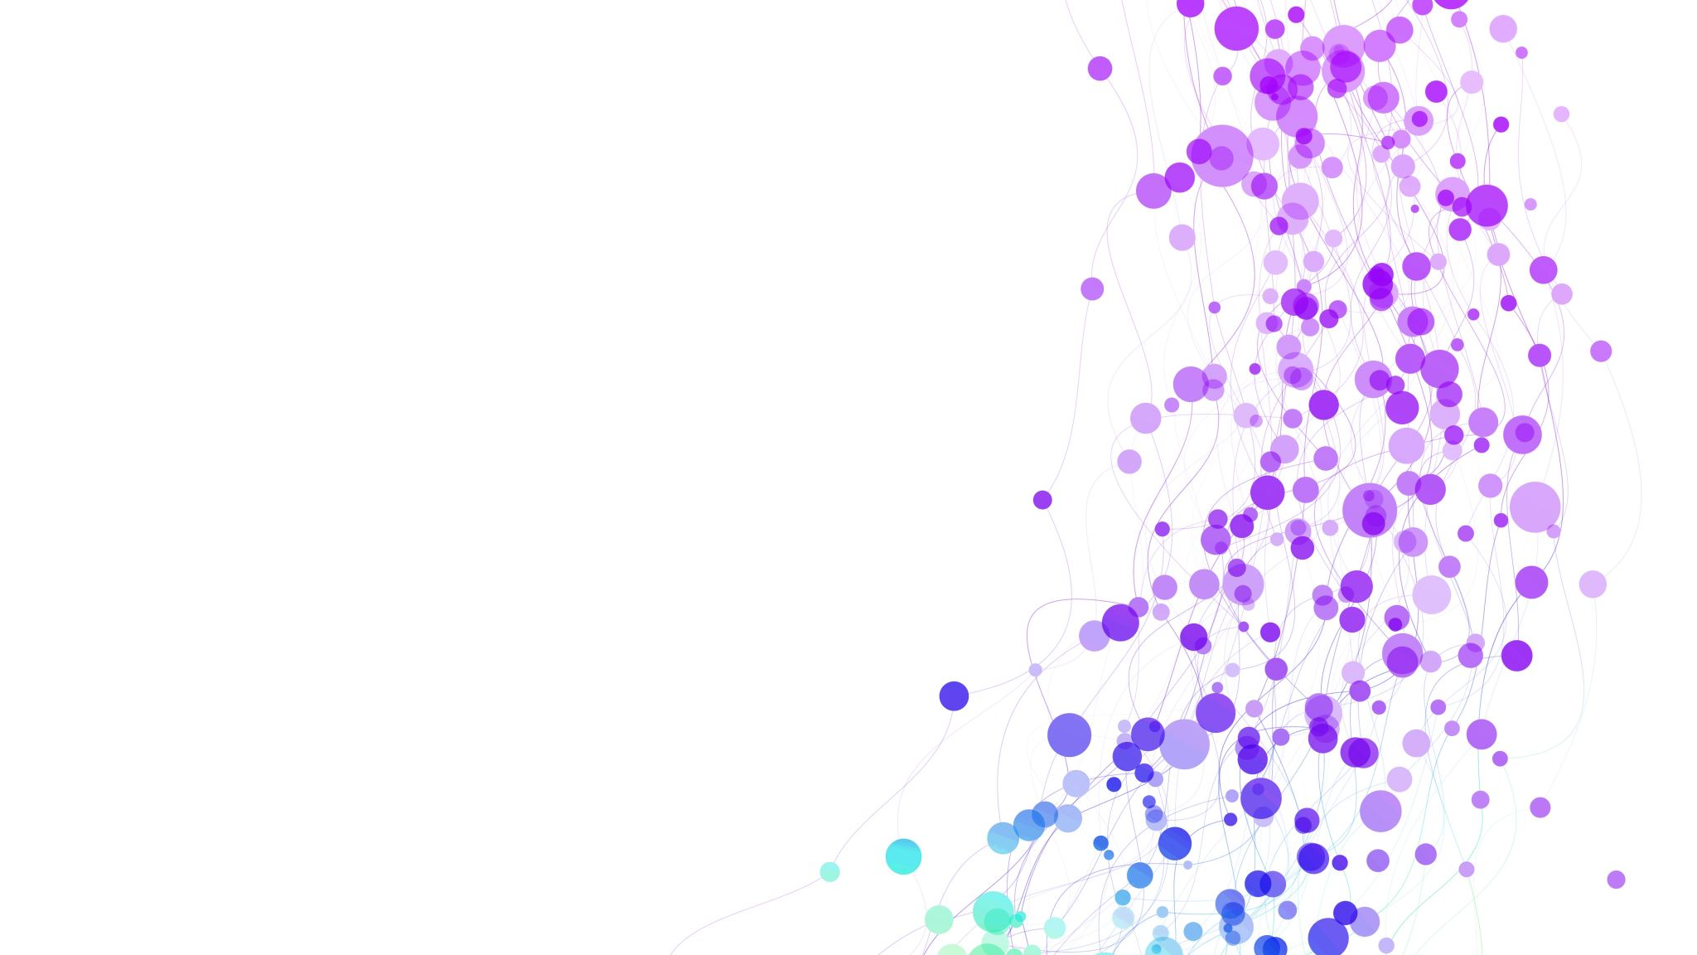
Requirements and Proposed Solution
Requirements
The library organization was facing data quality challenges in their CSV datasets due to:
Solution
Azure Based Solution
Benefits
Reduced Manual Efforts
Null and incomplete records with duplication
Inconsistent formatting and Manual data cleansing effort
Increased operational overhead and delays
The existing manual process was:
Time-consuming ,error-prone and difficult to scale
Inefficient for recurring datasets
Python-based automated data cleansing
Validation and transformation logic
Automated clean CSV generation
CI/CD-based deployment automation using DevOps
Dashboard reporting for monitoring data quality improvements
Integration with Microsoft Power BI for visualization
Improved Data Accuracy and consistency
Faster processing and Reporting
Repeatable and scalable workflow
Automated Deployment and Maintenance
Better visibility into Data metrics

Slide 2
Architecture Diagram
Source Library Data (Raw CSVs) | | (Azure Blob Storage - Raw Container)
Python ETL Processing Layer
Python scripts for data cleaning (Triggered via Azure Automation / Scheduled Run)
CI/CD Automation Layer (DevOps)
Azure DevOps Repos (Source Code Management)
Highlights of this Architecture
Fully cloud-native and scalable
Event-driven automation possible
CI/CD ensures reliable deployment
Separation of storage, compute, and visualization
Enterprise-grade observability and monitoring
Cleaned Data Storage Layer
Azure Blob Storage (Clean Container)
Power BI Reporting & Dashboard Layer Scheduled Run)
Microsoft Power BI with connection to Azure blob |

Slide 3
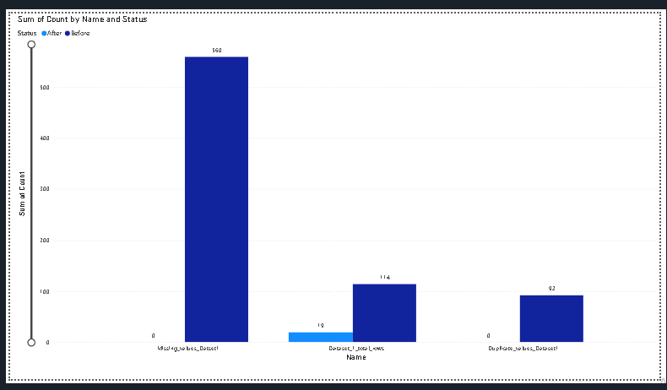
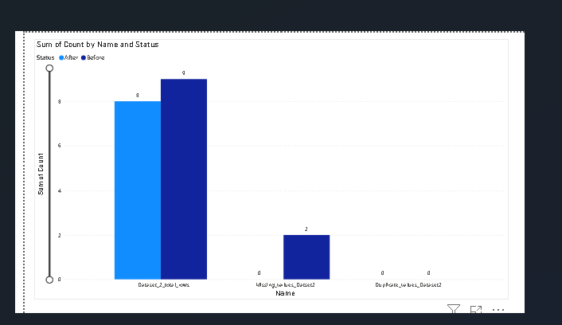
Power BI Metrics Dashboard
Dashboard Sections
Dataset Summary
Total Records
Total Columns
Processed Files
Dashboard Sections
Dataset Summary
Total Records
Total Columns
Dashboard Sections
Dataset Summary
Null Reduction
Duplicate Reduction
Data Accurancy Improvement
Dataset 1
Dataset 2

Slide 4
Risk and SWOT Analysis
Technical Risk
Unexpected data format changes
Incomplete validation rules
Dependency failures in automated pipelines
Operational Risks
Incorrect cleansing rules affecting valid data
Dashboard Sections
Dataset Summary
Validation checkpoints
Logging and exception handling
Version-controlled deployments
Testing in lower environments before production
Strength | Weakness | Opportunities | Threats
Automated data cleansing | Dependent on predefined rules | Expand to real-time ingestion | Operational dependency on automation
Reduced manual effort | Initial setup complexity | Integration with databases/cloud | Data governance compliance issues
Improved data quality | Pipeline failures impacting reporting | Advanced analytics & AI validation | Rapid changes in source data formats

